Slide 1


Project Presentation

Slide 2

Resume Generator

Slide 3

INTRODUCTION
I am going to present my project on Resume Generator that is a website. This presentation gives an overall description of a project.
In this presentation overview, we are going to tell you a complete detailing of a project like the idea behind the project and all the implementation that will be done by me.
All the implementation, designing, and execution of a project done by me under the guidance of Mr. Ankit Verma

Slide 4

SCOPE OF THE PROJECT
Provides instant resume to individuals
Better Problem Solving
There are choices available for resume format for users as per their qualification and requirements.
The system saves time and reduces human efforts.
Reduces tedious work in thinking and creating resume and is convenient for users.
FASTER PRODUCTION

Slide 5

FEATURES OF THE PROJECT
FAST PERFORMANCE
RELIABLE PERFORMANCE
REMOTE LOGIN
MINIMISE POTENTIAL HUMAN ERRORS
EASY ACCESS TO THE DAY TO DAY ACTIVITIES
EFFICIENT EMPLOYEES CAN BE IDENTIFIED EASILY
INCREASE COMPETITIVE ADVANTAGE

Slide 6
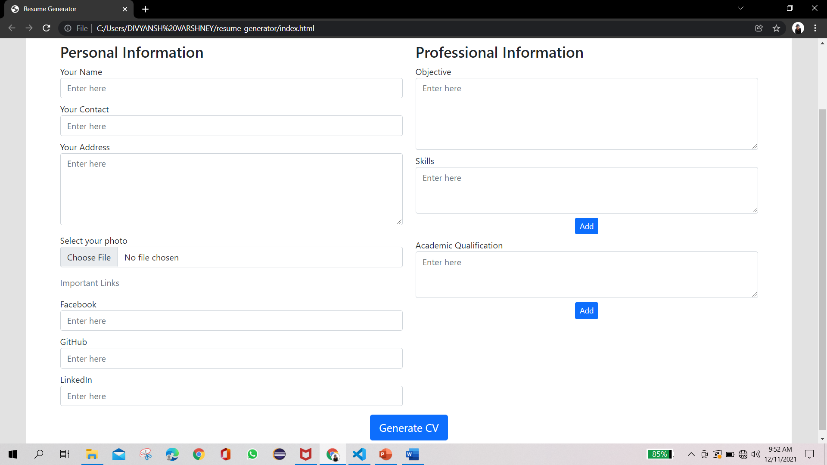
Design:-

Slide 7


DO YOU HAVE ANY QUESTION ? PLEASE ASK AND GIVE THE FEEDBACK

